Slide 1
Introduction to the C Language

Slide 3
Background of C
  C is a middle level language it combines the best elements of high-level languages with the control and flexibility of assembly language.
  Like most modern languages, C is also derived from ALGOL 60 (1960).
  Developed by Dennis Ritchie in 1972 using many concepts from its predecessors – ALGOL,BCPL and B and by adding the concept of data types.
  American National Standards Institute (ANSI) began the standardization of C in 1983 which was approved in 1989
  In 1990 International Standards Organization (ISO) adopted the ANSI standard version known as C89.
  Minor changes were made to C89 in 1995 which came to be known as C95
  Much more significant updates were made in 1999 and named as C99

Slide 4
Features of C
  C is a structured programming language which allows compartmentalization of code and data.
  A structured language offers a variety of programming possibilities. For example, structured languages typically support several loop constructs, such as while, do-while, and for.
  A structured language allows one to place statements anywhere on a line and does not require a strict field concept.
  In a structured language, the use of goto is either prohibited or discouraged and is not the common form of program control.

Slide 5
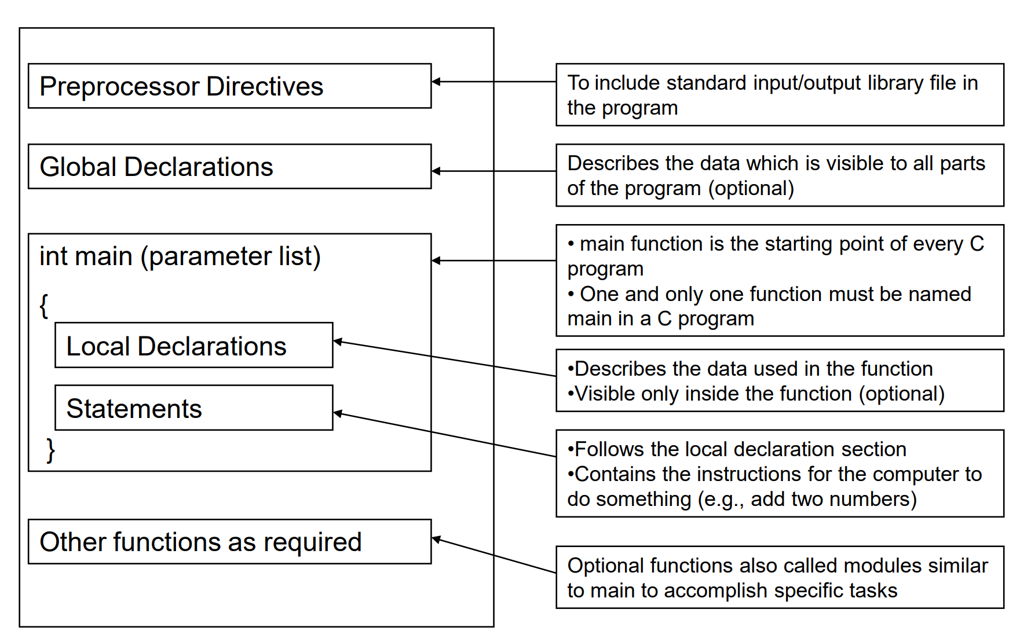
Structure of a C Program

Slide 6
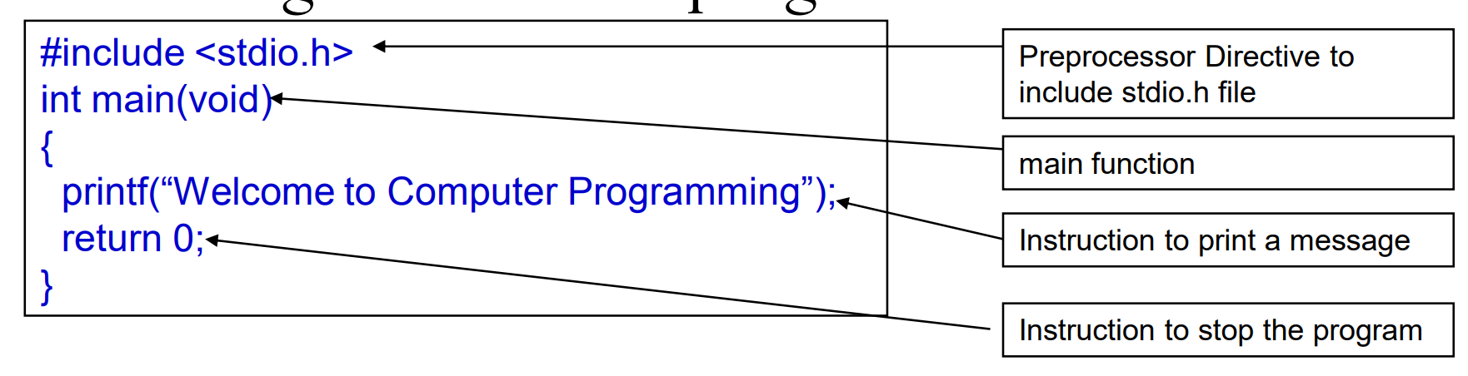
Dissecting a minimal C program

Slide 7
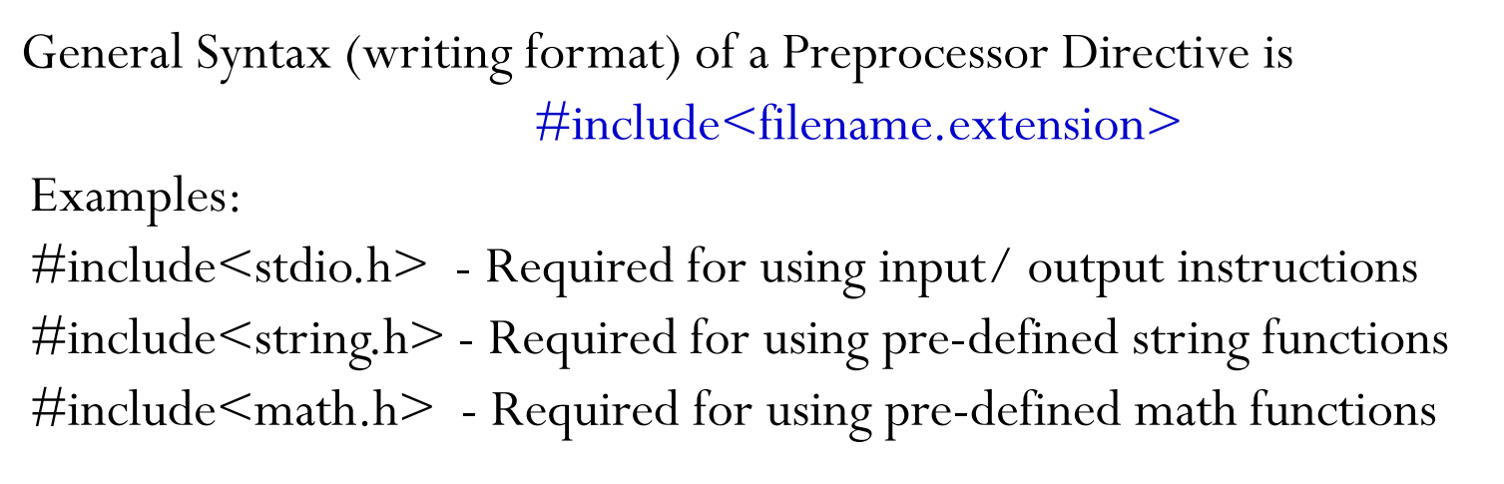
Dissecting a minimal C program
  The first C program has.
      Preprocessor Commands- placed at the beginning starting with #, tells the computer to include standard input/output library file (stdio.h) needed to print the message. Wrt bet <>
      Main function-Executable part of the program begins with main function General Syntax: int main. “int” indicates the function will return an integer. “void” main does not require any parameters.

Slide 8
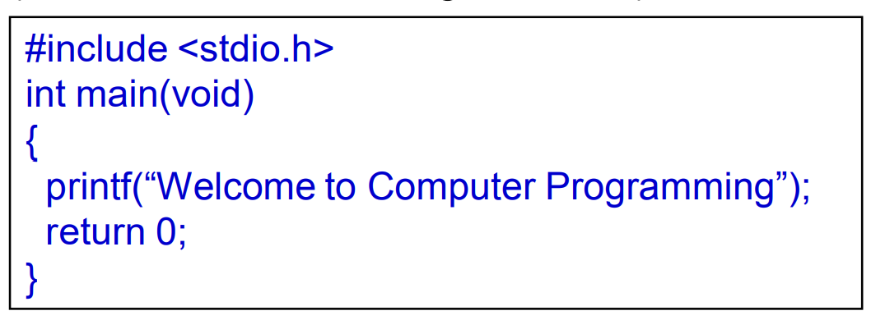
Creating and Compiling the minimal C program

Slide 9
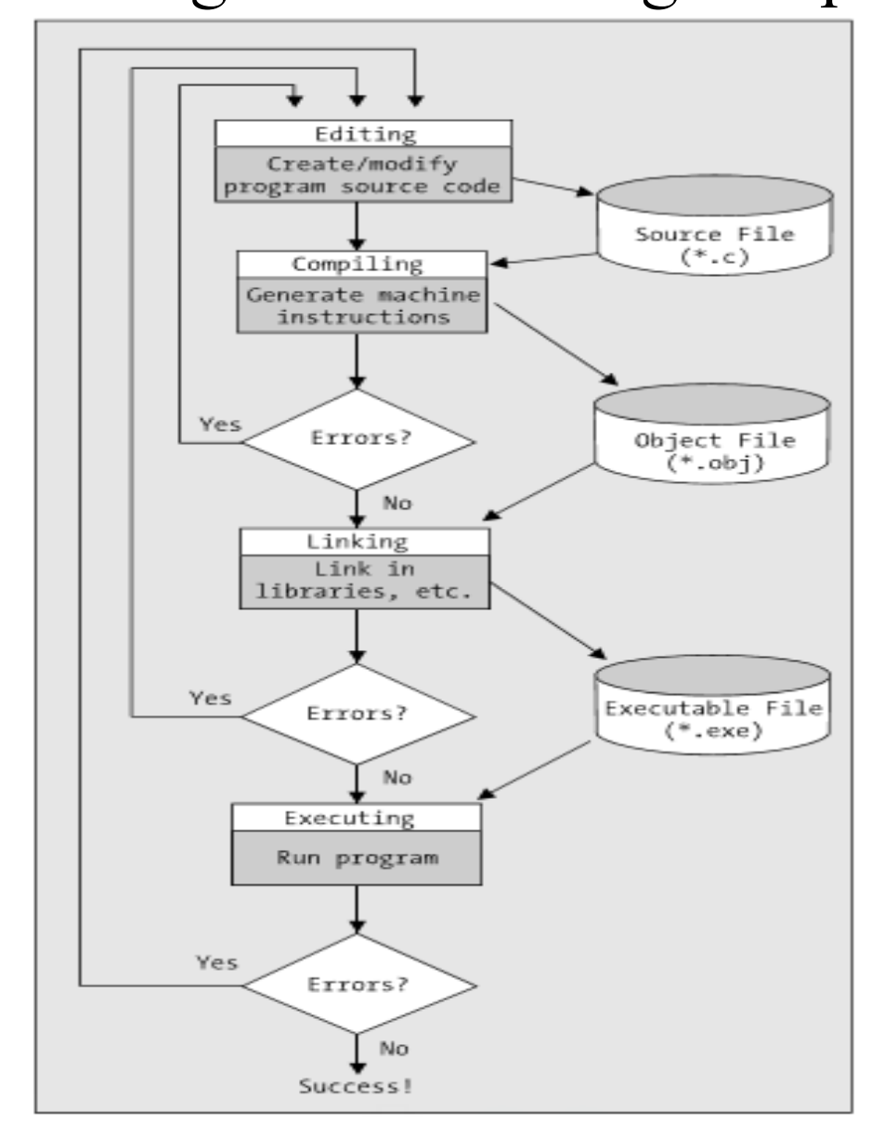
Summary of writing and executing a C program

Slide 10
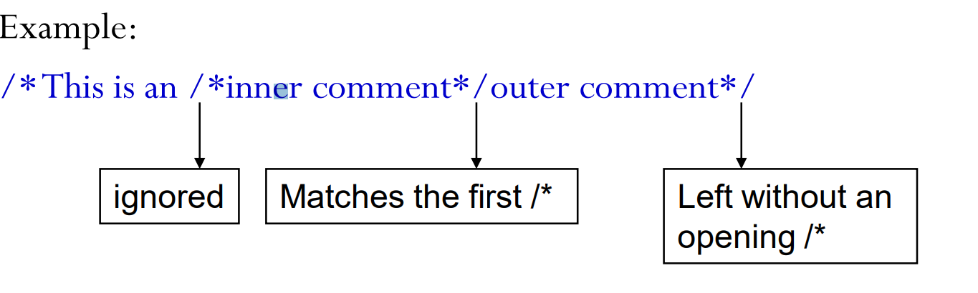
C Comments
  /*Help the reader to understand the meaning of sections of code which are not very clear.
  Are internal program documentation.
  Compiler ignores the comments when translating the program to executable code. */
  Two comments formats:
      Line comment: Uses // eg. //This is a comment.
      Block comment: Used when comment spans several lines. /*comment */
        Caution with comments- Should not be nested.

Slide 11
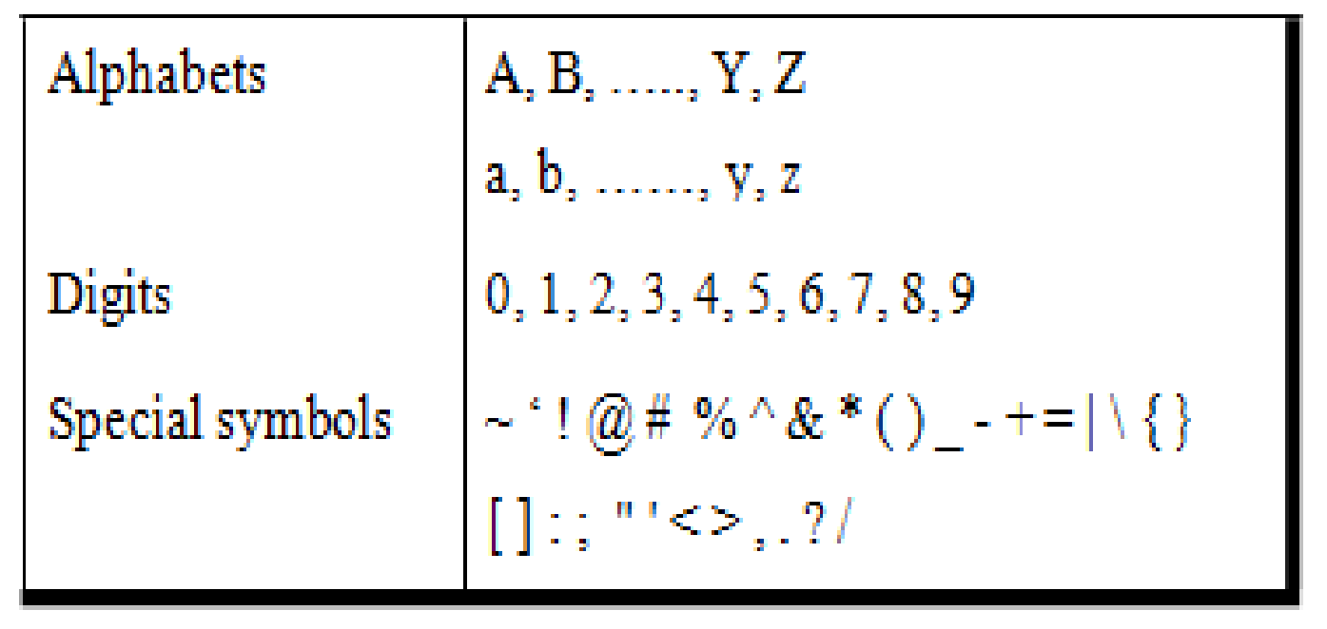
The C Character Set
  Character set specifies the valid symbols that can be used in a C program.
  Symbols and escape sequence characters

Slide 12
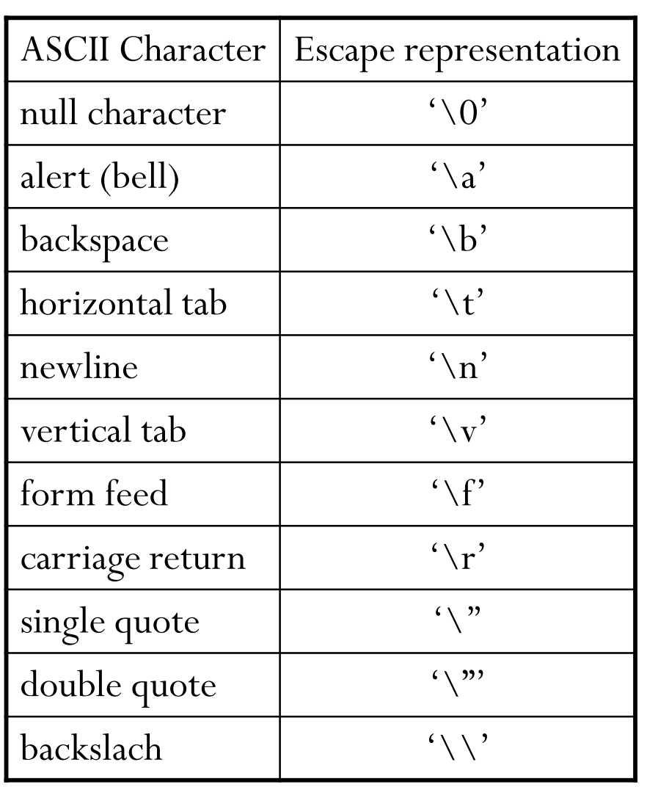
Escape Sequence characters
  Escape sequence characters are a combination of two characters but treated as a single character.
  Often used in printf statements, they are not printed explicitly on the screen but the effect of these characters can be observed.
  The table beside shows some ASCII characters and their corresponding escape character format

Slide 13


Exercises
  Write a program that will output your name and address using a separate printf() statement for each line of output.
  Write a program to print the pattern of asterisks as shown below
  Write a program to print the following figure using suitable characters

Slide 14
Solutions
  #include<stdio.h>
  int main()
  {
  printf(“John Doe, ");
  printf("Asst.Professor, CSE Dept, ");
  printf("Amrita School of Engineering, ");
  printf("Amrita Vishwa Vidyapeetham, ");
  printf("Amrita Nagar Post, ");
  printf("Coimbatore 641 112 ");
  return 0;
  }

Slide 15
Solutions
  //Prints a triangular pattern - Author: John Doe
  #include<stdio.h>
  int main()
  {
  printf("*\n"); //prints first line
  printf("*\t*\n");
  printf("*\t*\t*\n");
  printf("*\t*\t*\t*\n"); //prints last line
  return 0;
  }

Slide 16
Solutions
  //Prints a pattern - Author: John Doe
  #include<stdio.h>
  int main()
  {
  printf("---------- ----------\n"); // Prints the top horizontal bars
  printf("| | >> | |\n"); // Prints the vertical bars and the arrows
  printf("| | | |\n"); // Prints the second set of vertical bars
  printf("---------- ----------\n"); // Prints the bottom horizontal bars
  return 0;
  }

Slide 17
Identifiers in C – (Recollect Name Bindings in CTPS)
  Identifiers allow us to name data and other user created components in a program
  Each identified component is stored at a unique location in the computer’s memory.
  With no identifiers to symbolically represent data locations, we should know and use the component’s memory address.
  Using Identifiers, we simply name the data and let the computer keep track of where they are physically located in the computer’s memory

Slide 18
Rules for Identifiers in C
  Valid alphabets for naming are A to Z, and a to z. student
  _(underscore) is the only special symbol. Student, student, allxt
  Numbers from 0 to 9 can be used, however, 1st symbol cannot be a number. 2student. Student109, Stu91tr
  The first symbol of an identifier must be an alphabet or an underscore. StudentID, _StudentID
  Typically application programs do not use underscore as the first symbol because many of the identifiers in C system libraries start with an underscore. Student_ID
  C has 32 keywords also known as reserved words, which have a predefined meaning and cannot be used as identifier names.

Slide 19
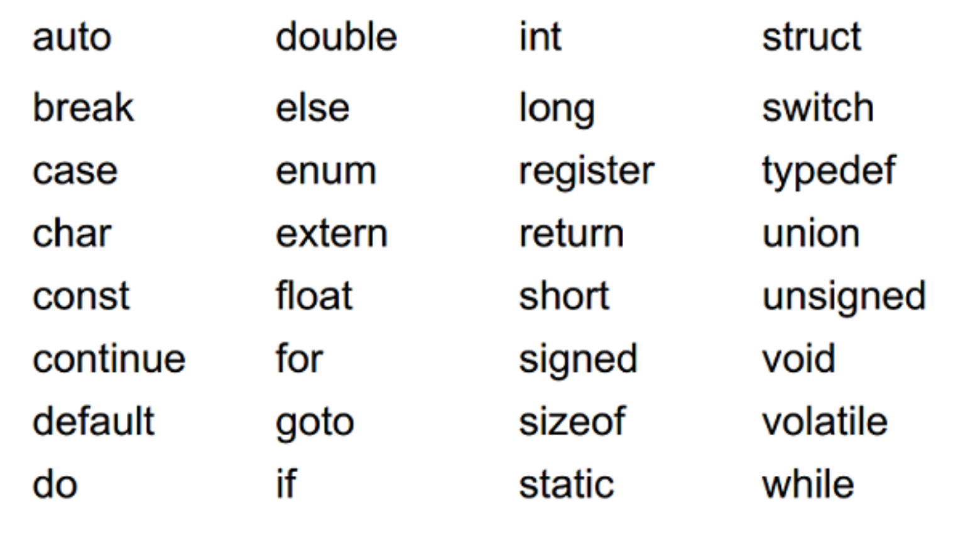
Some Keywords/Reserved words in C

Slide 20
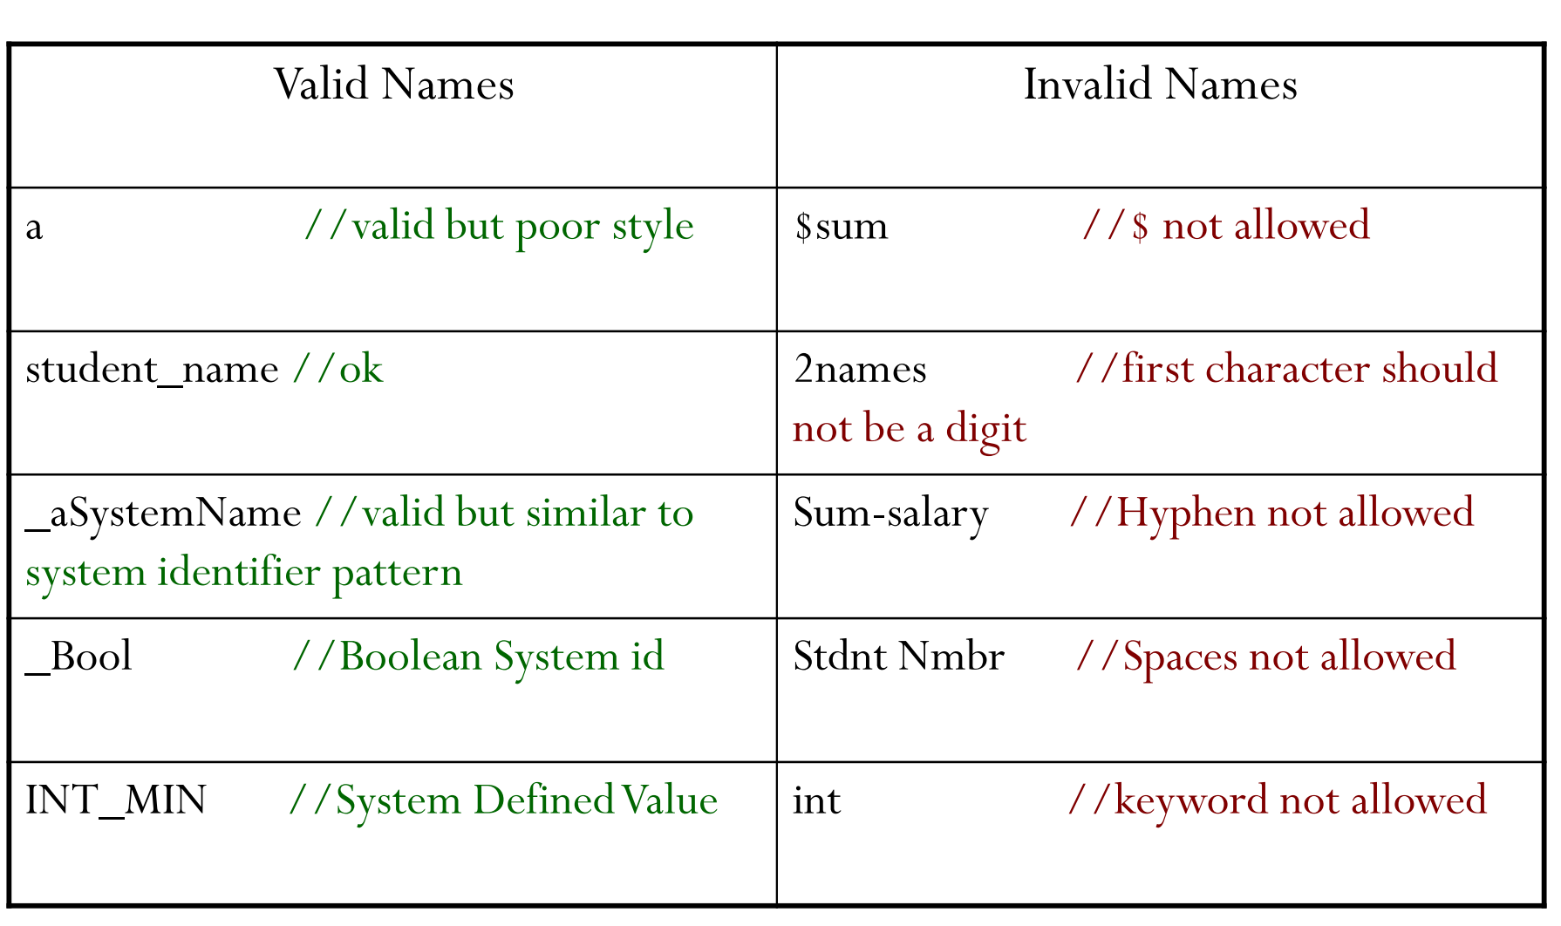
Examples of Valid and Invalid Identifier Names

Slide 21
Exercises
  Identify whether the following identifiers are valid. If not give reason and correct them (a) record1 (b) #tax (c) name_and_address (d) 1record (e) name (f) name-and-address (g)file_3 (h) name and address (i) return (j) T23-45-6789
  Assume a version of C that can recognize only the first 8 characters of an identifier name, though the identifier names can be arbitrarily long. Which of the following pairs of identifier names are considered to be identical and which are distinct? (a) name, names (b) address, Address (c) list1, Iist2 (d) char1,char_1 (e) identifier_1, identifier_2 (f) answer, ANSWER

Slide 22
Types in C
  A type defines a set of values and a set of operations that can be applied on those values.
  For example a light switch can be compared to a type
      It can have two values on and off/
      Only two operations can be applied to the light switch: turn on and turn off

Slide 23
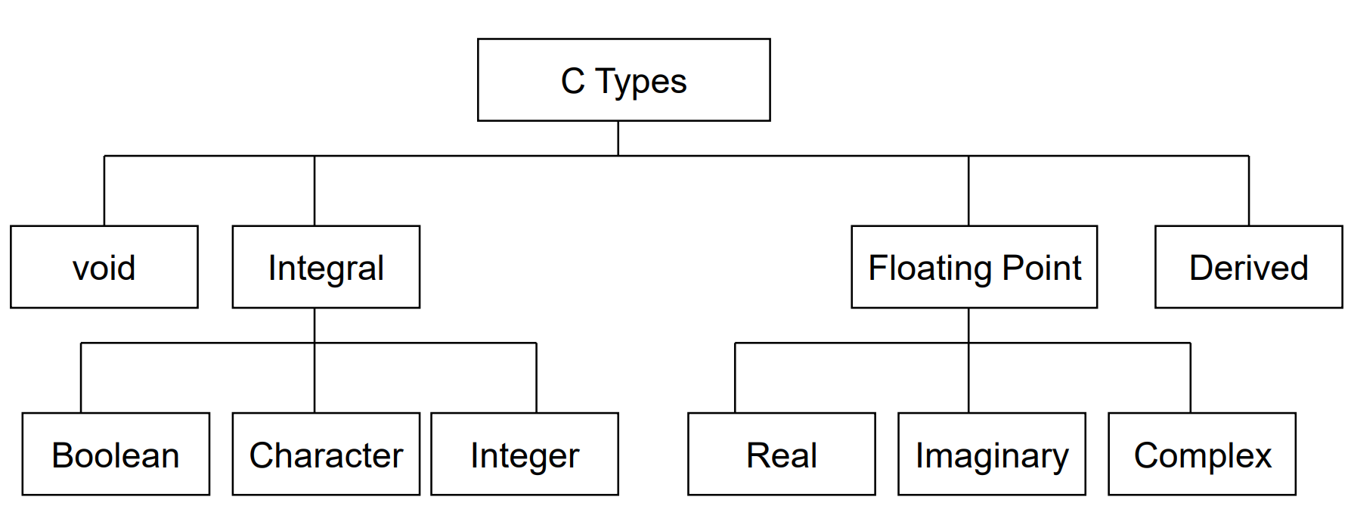
Types in C
  The defined set of types in C can be divided into four general categories: void, integral, floating-point and derived.

Slide 24
Types in C
  Void Type:
      Is designated by the key word void
      Has no values and no operations
      Very useful type
      Used in cases where a function has no parameters or return values and for many other purposes which will be covered in the forthcoming topics.
      Integral type:
          Contains only number quantities.
          C has 3 types of integral parts: Boolean (T or F), Character also char (symbols), and integer (whole numbers).

Slide 25
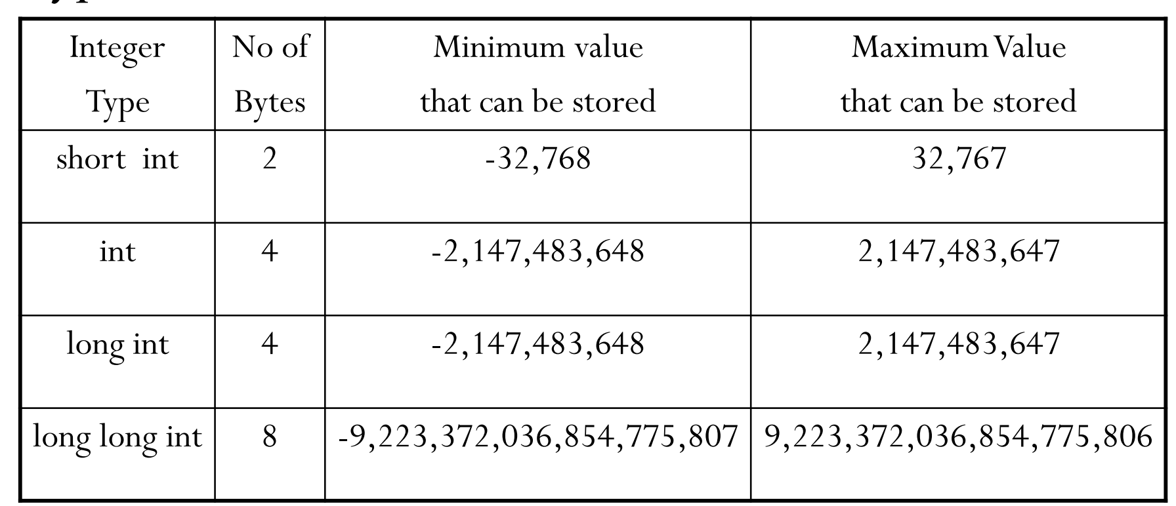
Types in C

Slide 26
Types in C
  Floating-Point Type:
      Real type holds values with fraction and integer can be (float, double and long double). 34.5 students.
      Imaginary type: component of complex type, C does not support it.
      Complex type: Similar to real type can be of three different sizes: float complex, double complex and long long complex.

Slide 27
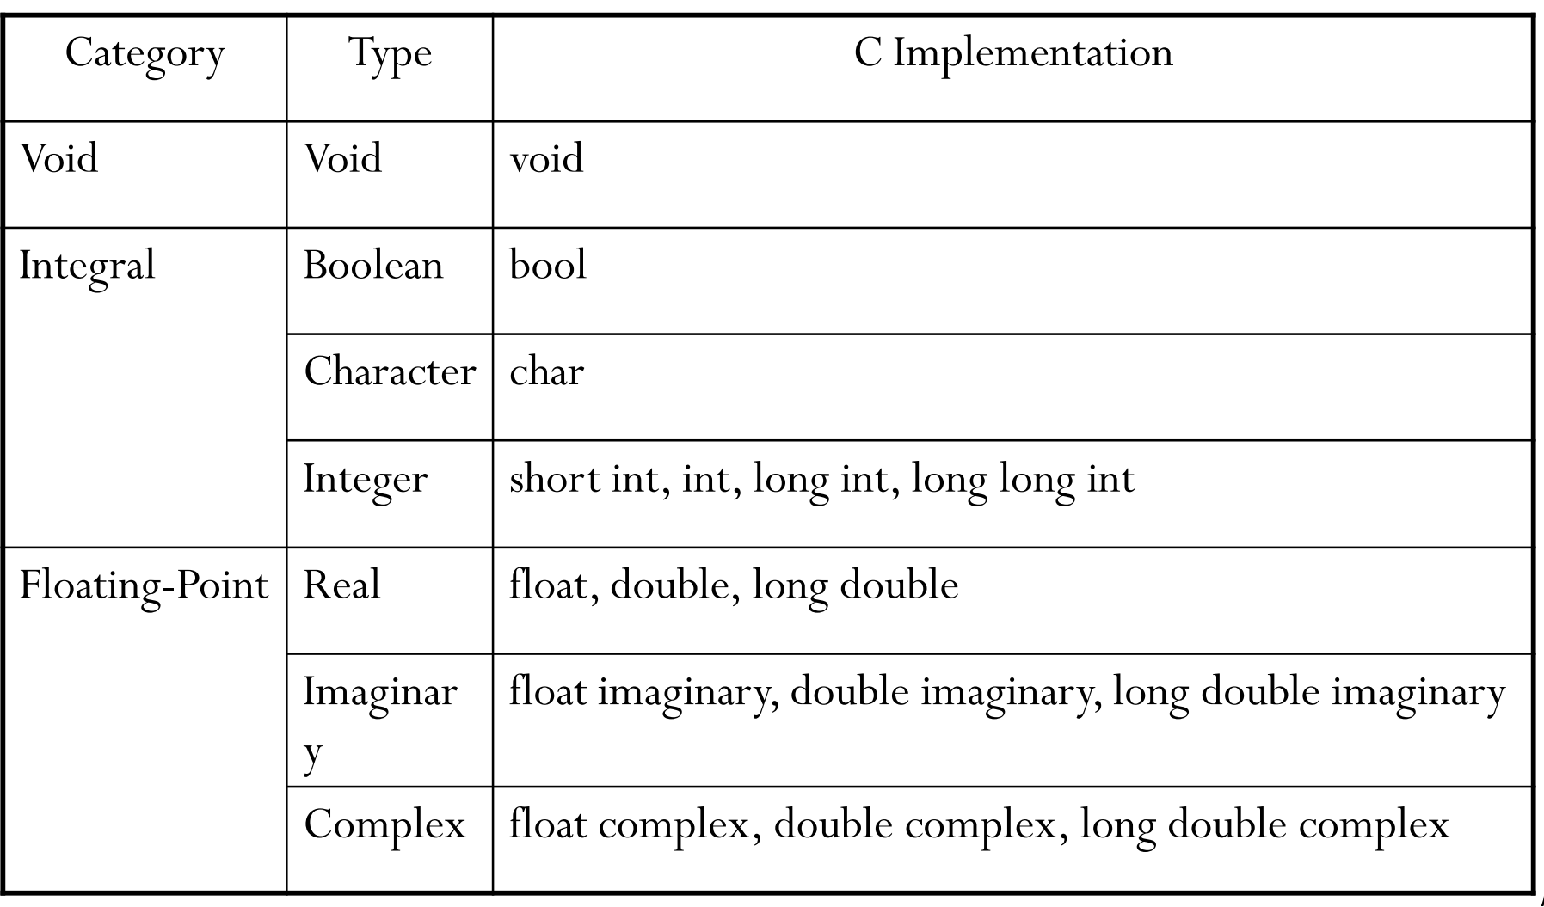
Types in C
  Summary

Slide 28
Variables in C
  Variables are named memory locations which have a type such as integer or character.
  The types specified for a variable determines the value that the variable may contain.
  Variable must be declared.
  A C declaration is giving name to a variable.
  Once defined, variables are used to hold the data required by the program for its operation.
  Definition reserves memory for the variables

Slide 29
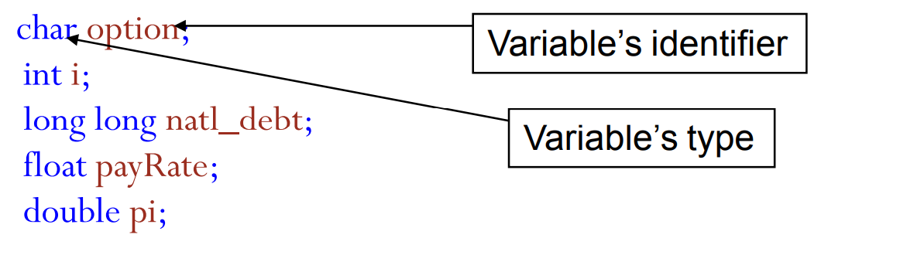
Variables in C
  Examples of variables declaration.
  To create a variable, first specify the type, which automatically specifies its size (precision) and then its identifier
      For example
    float price;
  denotes the definition of a real variable named price of type float

Slide 30
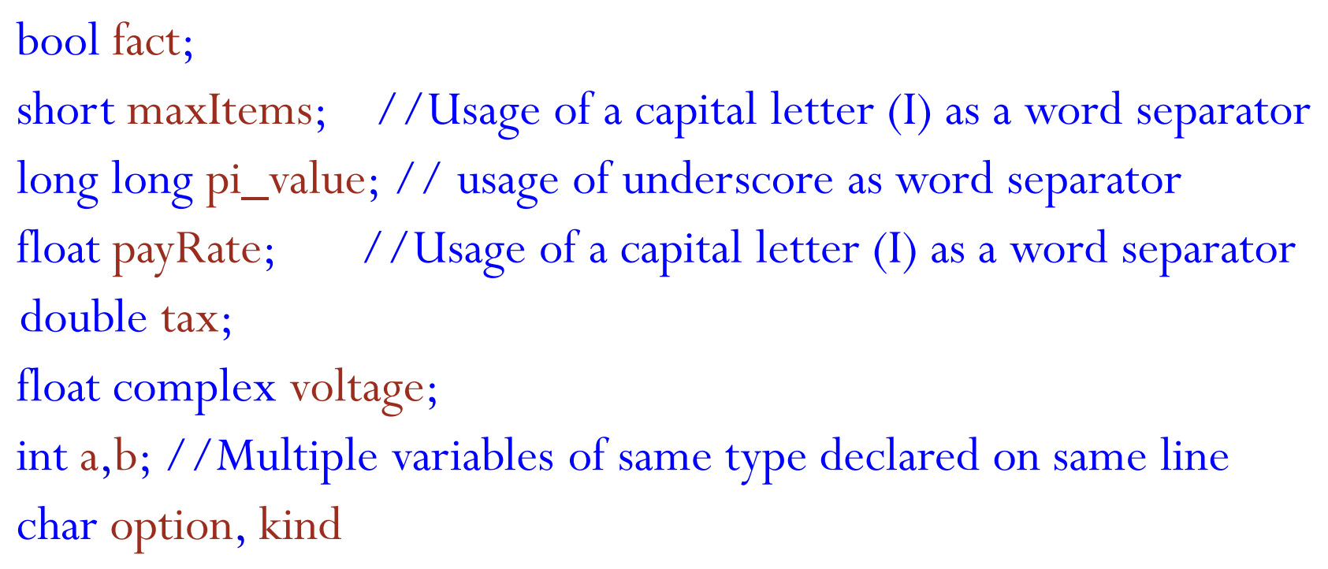
Variables in C
  Examples of variables declaration.

Slide 31
Variables in C
  Variable Initialization
    When variables are defined, they usually contain meaningless values.
    There is the need to store data in them by initialization before accessing the value.
    A variable can be initialized at the time of declaration using an initializer.
    Example:
      int count = 0;
  Every time the function containing count is entered, count is set to zero
  Question: Are both counts and sum initialized in int count, sum=0; - No, only sum is initialized.

Slide 32
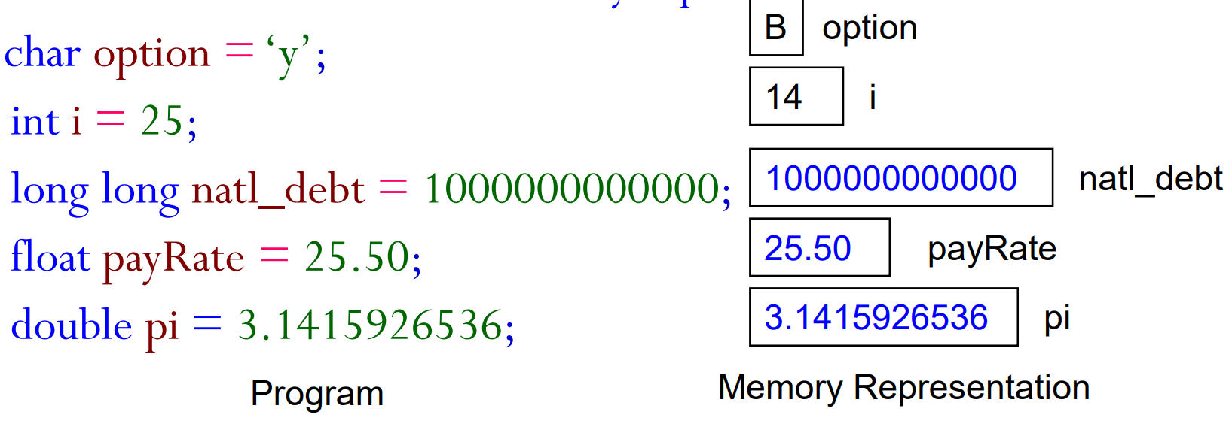
Variables in C
  Variable Initialization
    To avoid confusion and error, declaration is done per line.
      int count = 0;
      int sum =0;
      Revisit variable declaration and definition along
      with initialization and the memory representation

Slide 33
Constants in C
  More constants
      Coding constants- e.g. liberal (unnamed constant used to specify data such as a=b+5), defined constant (uses #define), and memory constant (indicates that the data cannot be changed e.g. const type identifier = value;

Slide 34
Constants in C
  Constants are data values that cannot be changed during the execution of a program.
  Like variables, constants also have a type.
      Boolean: Have only one value T or F, use library stdbool.h
      Character: Enclosed in quotes ‘a’, escape character is preceded by a backslash \ so ‘\n’
      Integer: numeric
      Real:
      Complex:
      String constants: a sequence of zero or more characters enclosed in double quotes. “Hello world\n”

